Slide 1

Analysis of Employee Reviews: Amazon, Apple, Facebook, Google, Microsoft and Netflix
Group E
Ning Shi
Himadri Tewari

Slide 2


Abstract
Employer reviews and employee review sites are an invaluable resource for job-seekers.
If you’re looking for a job and wondering what it’s like to work at a prospective company, you should take advantage of all the places online where you can hear from employees leaving user reviews of their workplaces. Gone are the days when you only heard a one-way message from the employers themselves within employee performance reviews.
Companies like Google, Facebook, Amazon, Apple, Netflix & Microsoft receive more than millions resumes per year. Whether they are receiving such high numbers of application due to their offerings like high salaries and perks or due to their technological innovations, it is clear that working for these tech companies are now dreams of many people.
But there is always an open question, “whether it is worth working for these companies or not?”. To get the answer of this question and to know more about these companies, we have to rely on their own employee’s reviews .
https://fairygodboss.com/career-topics/employer-review-sites-employee-reviews

Slide 3

About the data
Data Set – Over 67k employee reviews for Google, Amazon, Facebook, Apple, Netflix and Microsoft are collected from Kaggle dataset.
Data Source – The data is originally collected from Glassdoor – a website where current and former employees anonymously review companies and their management.
Link – https://www.kaggle.com/petersunga/google-amazon-facebook-employee-reviews

Slide 4

Attributes
Index – index
Company – Company name
Location – The dataset is global, as such it may include the country's name in parenthesis
Date Posted - in the following format MM DD, YYYY
Job-Title - This string will also include whether the reviewer is a 'Current' or 'Former' Employee at the time of the review
Summary - Short summary of employee review
Pros - Pros
Cons - Cons
Overall Rating - 1-5
Work/Life Balance Rating - 1-5
Culture and Values Rating - 1-5
Career Opportunities Rating - 1-5
Comp & Benefits Rating - 1-5
Senior Management Rating - 1-5
Helpful Review Count - A count of how many people found the review to be helpful
Link to Review - This will provide you with a direct link to the page that contains the review. However it is likely that this link will be outdated

Slide 5

Problem Statements
Comparison of Review trend over the year
Comparison of employee feedback over the year for each company
Current vs Former
Comparison of review comments between current and former employees
Company Summary
To summarize the attitude towards company based on 6 scores directly
Sentiment Analysis
To do a sentiment analysis based on the review comments

Slide 6

Attributes in Details
Int64Index: 67529 entries, 1 to 67529
Data columns (total 16 columns):
Index – index
company – 67529 non-null object
location – 67529 non-null object
dates - 67529 non-null object
job-title - 67529 non-null object
summary - 67409 non-null object
pros - 67529 non-null object
cons - 67529 non-null object
advice-to-mgmt. - 67232 non-null object
overall ratings - 67529 non-null float64
work-balance-stars - 67529 non-null object
culture-balance-stars - 67529 non-null object
career-opportunities-stars - 67529 non-null object
comp-benefit-stars - 67529 non-null object
senior-management-stars - 67529 non-null object
helpful-count - 67529 non-null object
link - 67529 non-null object
dtypes: float64(1), int64(1), object(14)
memory usage: 8.8+ MB

Slide 7
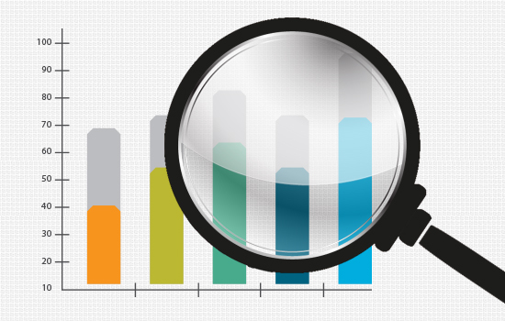
Exploratory Data Analysis (EDA)

Slide 8
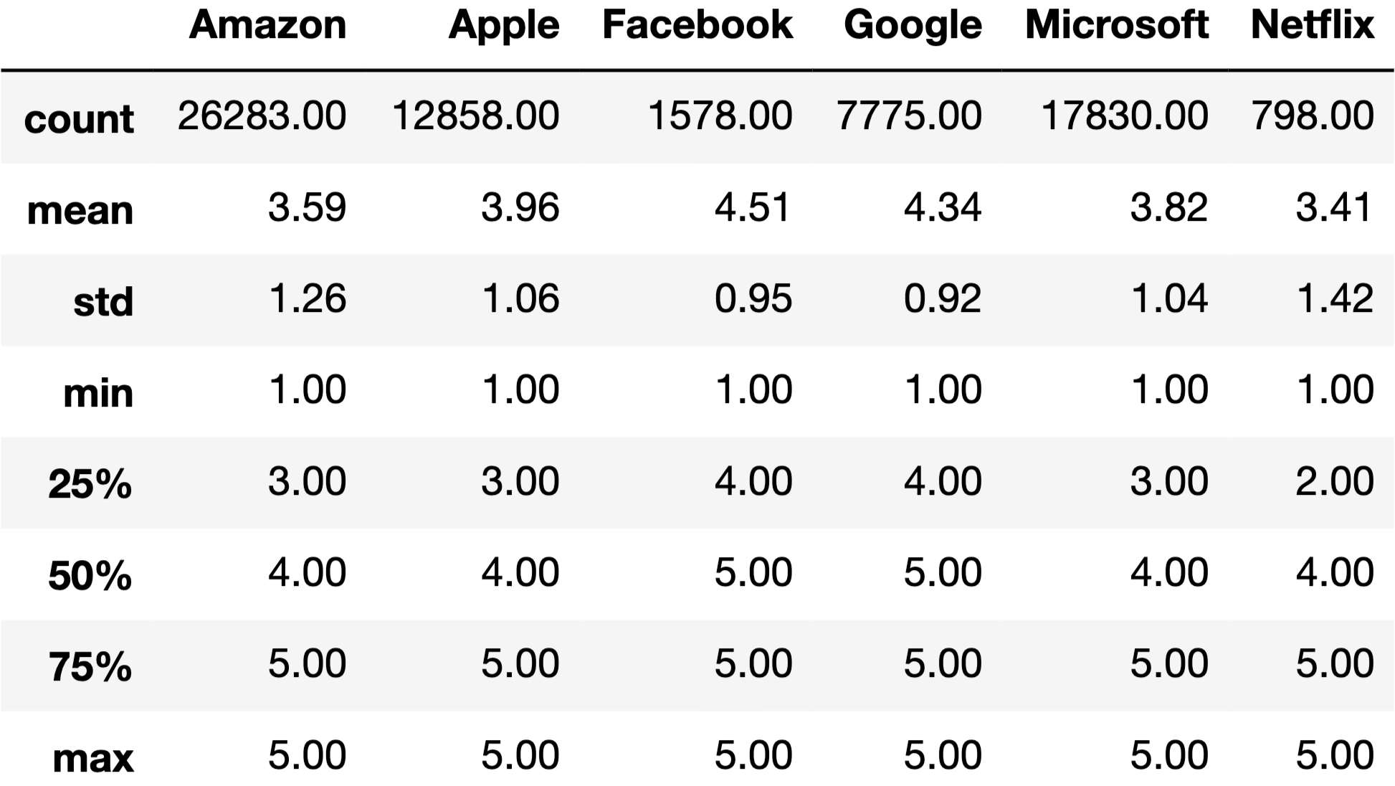
Distribution of Overall Rating per Company
Best - Facebook
Worst - Netflix
Low Variation - Google
High Variation - Netflix
All have 1.0 case
All have 5.0 case
Notes:
The slide provides the summary of the overall rating for each of the company present in the dataset. It contain the total count, mean, standard deviation, min, quantiles and the max

Slide 9
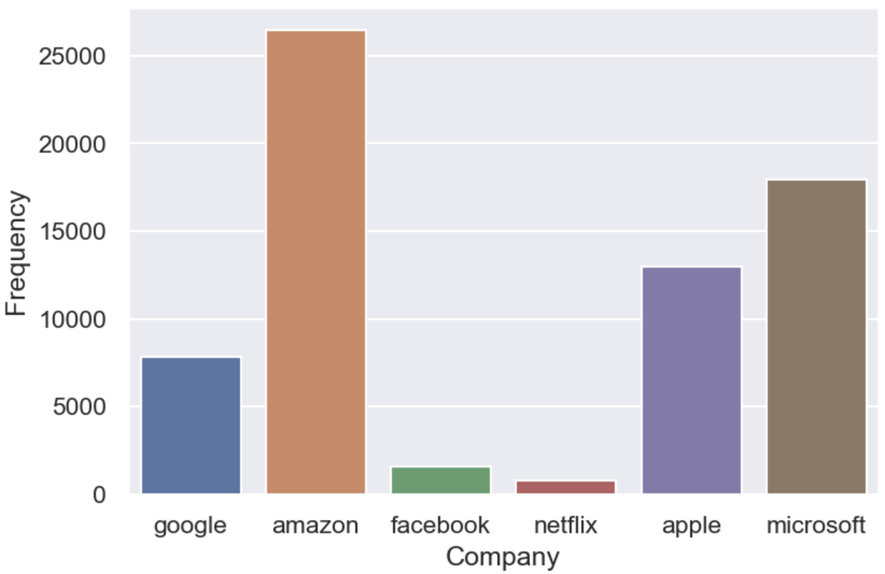
Review Number per Company
Amazon
Microsoft
Apple
Google
Facebook
Netflix

Slide 10
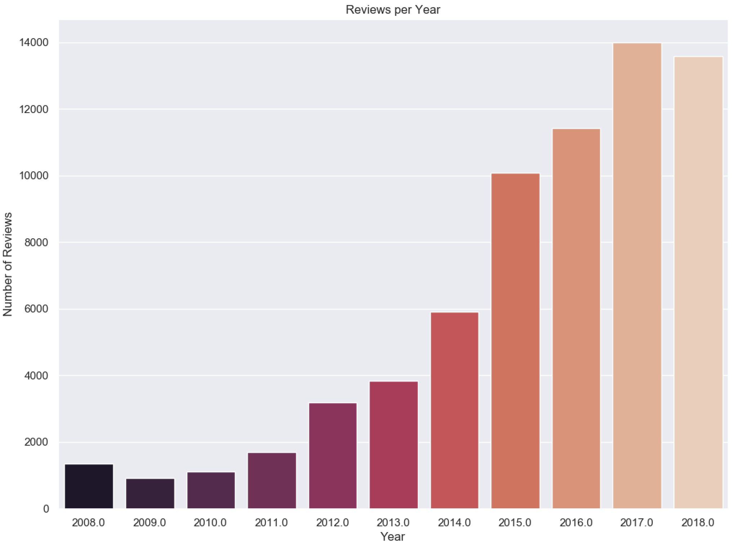
Review Trend per Year
General increasing
Since 2009
Data ranges from
2008
2018
Over ten years
Notes:
The chart shows the distribution and trends of the reviews changes each year. It is observed that the feedback process has increased over time, from which it can be inferred that employee review is one of the most effective process for any company’s business objective, work-environment and to maintain healthy employee-employer relationship

Slide 11
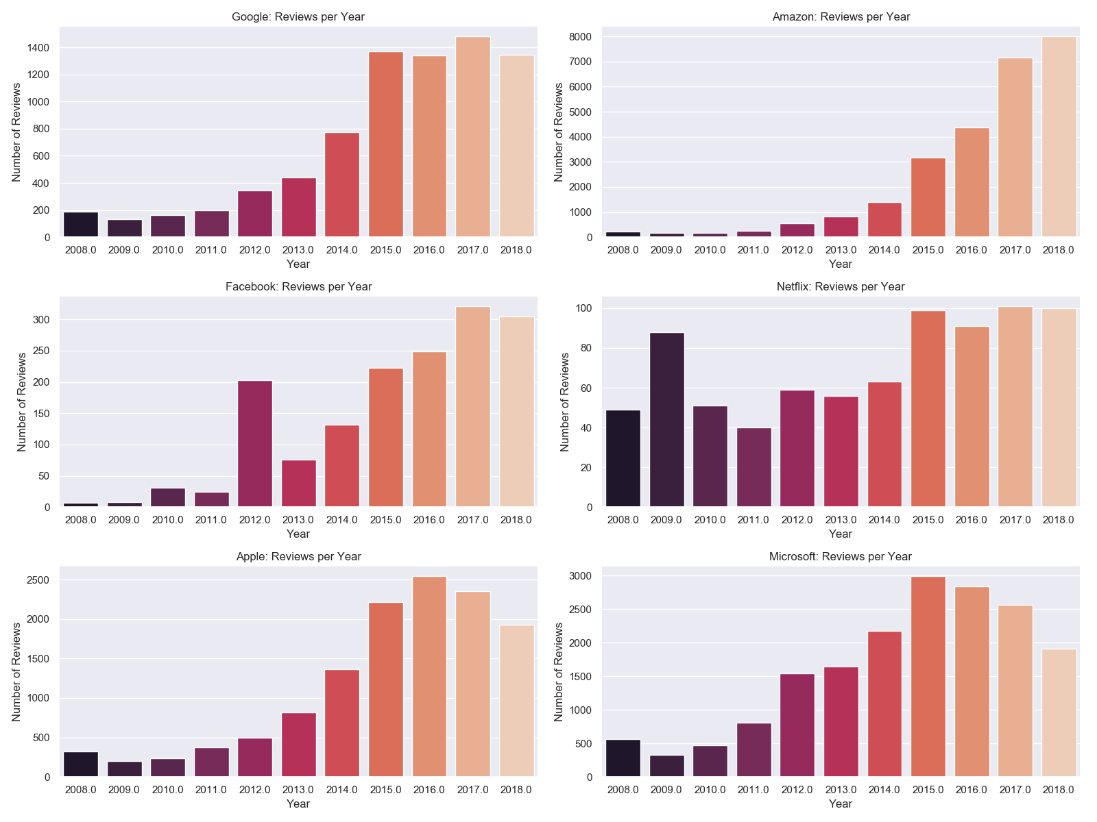
Distribution of Reviews per Company
Google
Amazon
Facebook
Netflix
Apple
Microsoft
Notes:
The chart shows the yearly distribution and trends of the reviews for each of the company in the dataset. It shows that for all the companies, the trend is more left-skewed (increase in employee feedback over time).

Slide 12
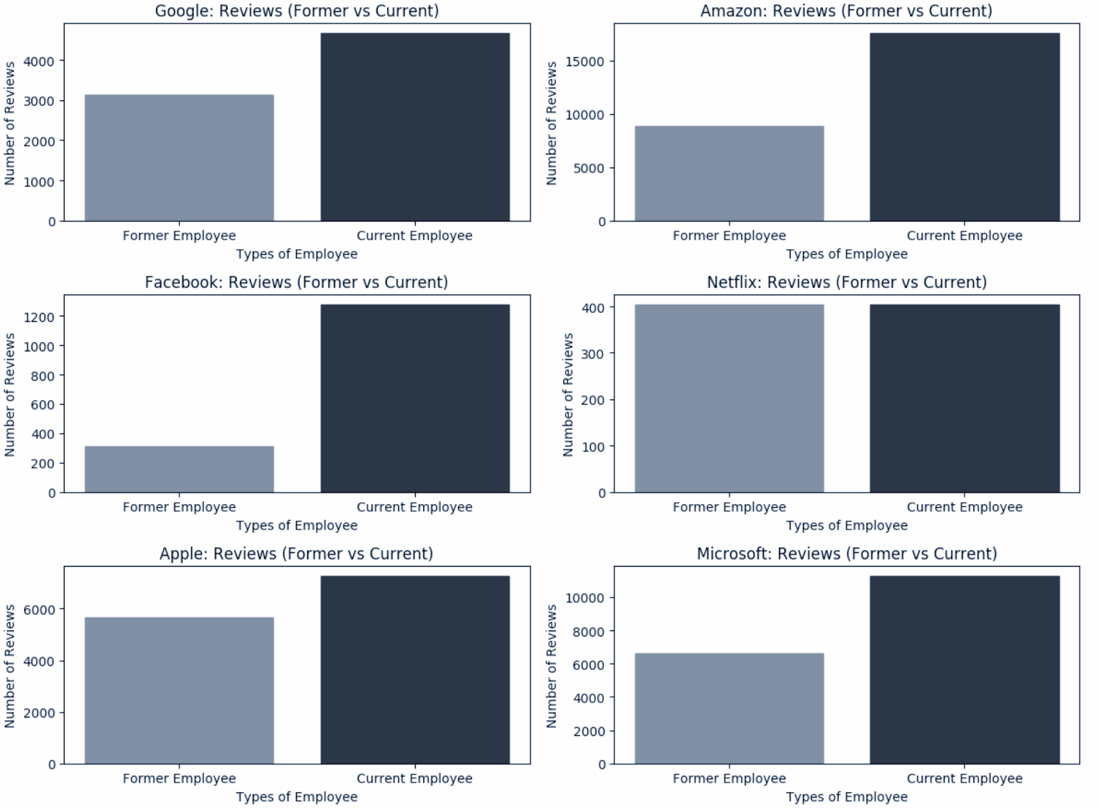
Review Count per Employee Type
Google
Amazon
Facebook
Netflix
Apple
Microsoft
Notes:
The chart provides the comparison of total number of reviews provided by Former vs. Current Employee for each company. From the chart, it can be deduced that former employees provide more feedback than current employees. However, for Netflix, the total number of feedback is almost same for current and former employee.

Slide 13
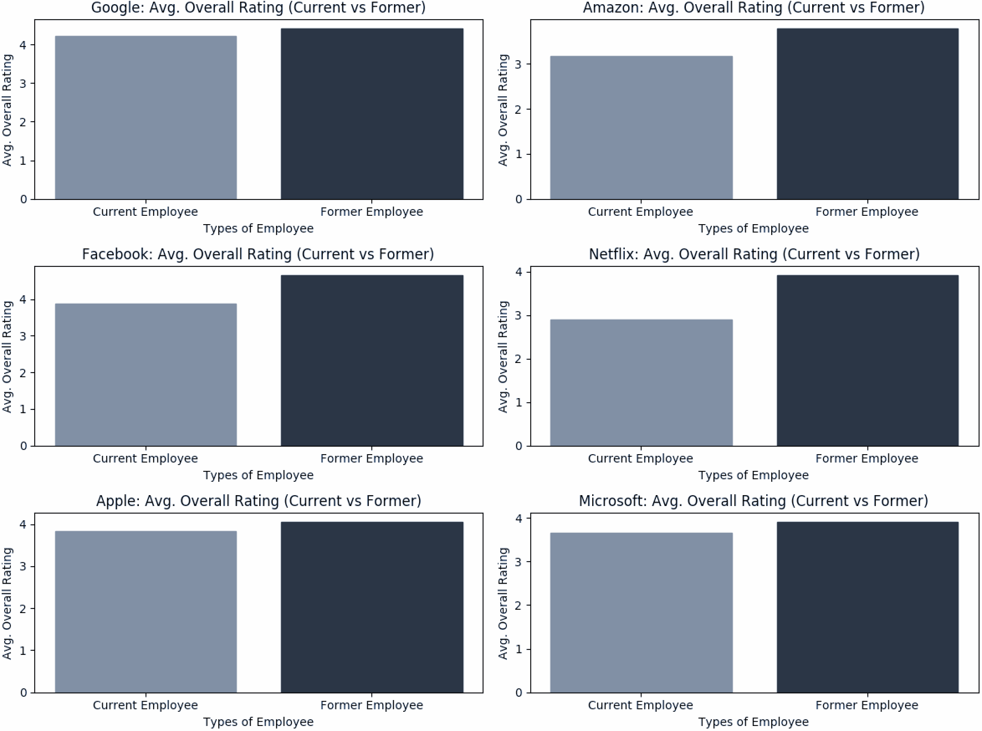
Overall Rating per Employee Type
Google
Amazon
Facebook
Netflix
Apple
Microsoft
Notes:
The chart provides the comparison of average overall rating provided by Former vs. Current Employee for each company. From the chart, it can be deduced that current employees provide a better feedback than former employees.

Slide 14
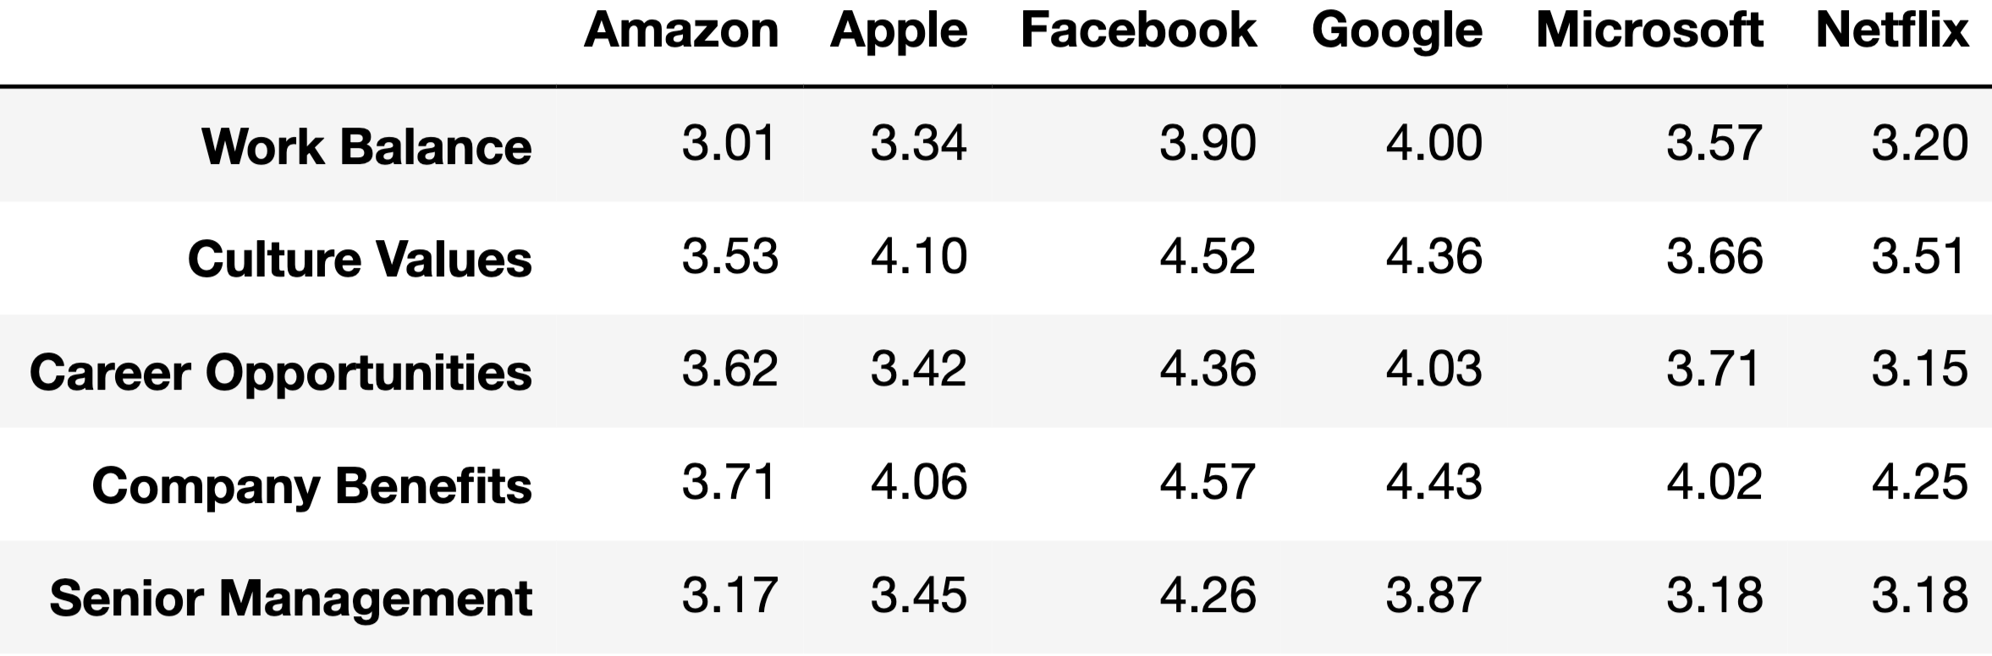
Distribution of Stars per Company
WB - Google
CV - Facebook
CO - Facebook
CB - Facebook
SM - Facebook
Notes:
The picture on the left is the table which contains the distribution of stars for each company. In the right side, the same number is visualized using the heat-map. It shows Facebook has got the highest values in all the categories present followed by Google. The other companies has a similar or evenly distribution of the data.

Slide 15
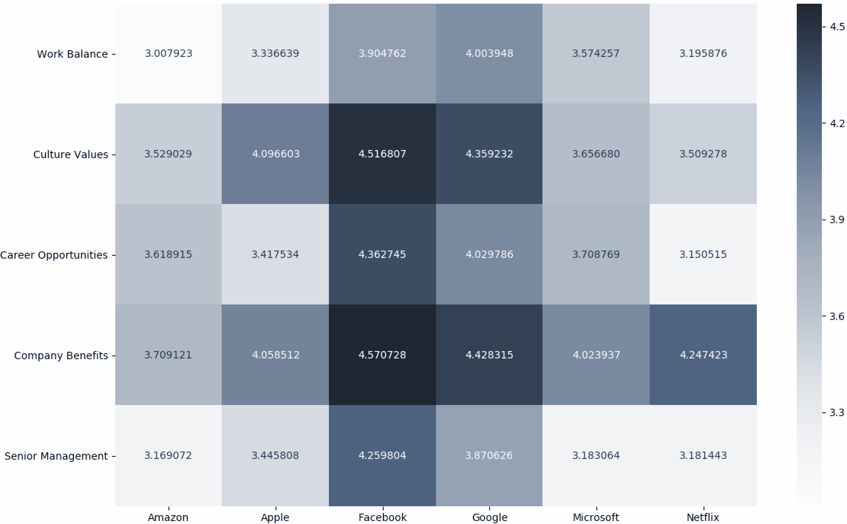
Distribution of Stars per Company
Notes:
The picture on the left is the table which contains the distribution of stars for each company. In the right side, the same number is visualized using the heat-map. It shows Facebook has got the highest values in all the categories present followed by Google. The other companies has a similar or evenly distribution of the data.

Slide 16
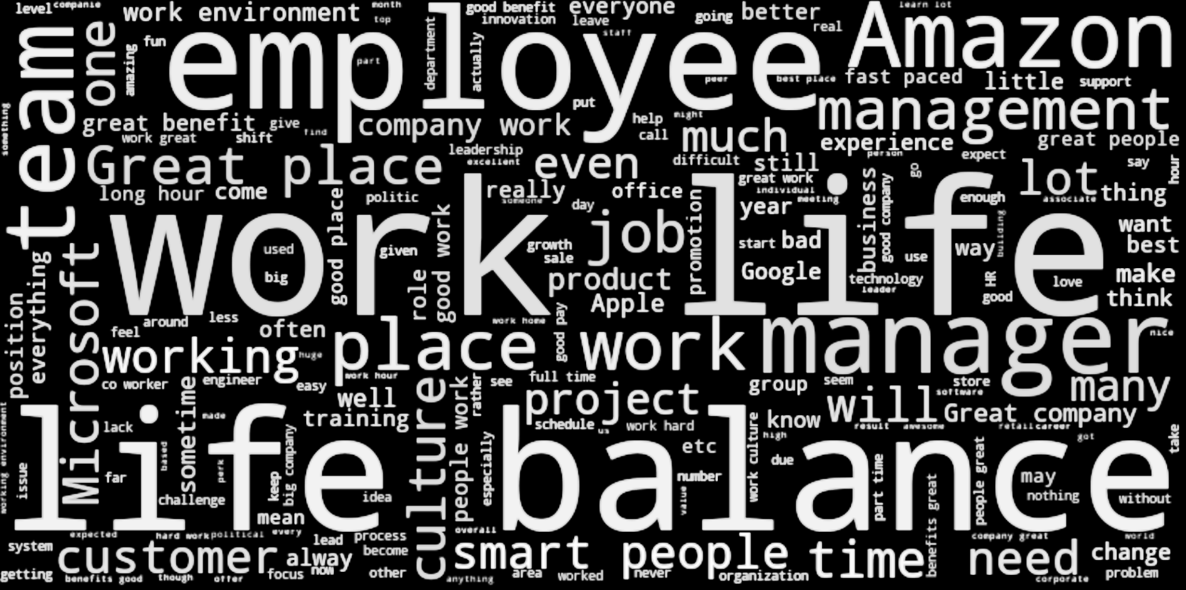
Word Cloud

Slide 17
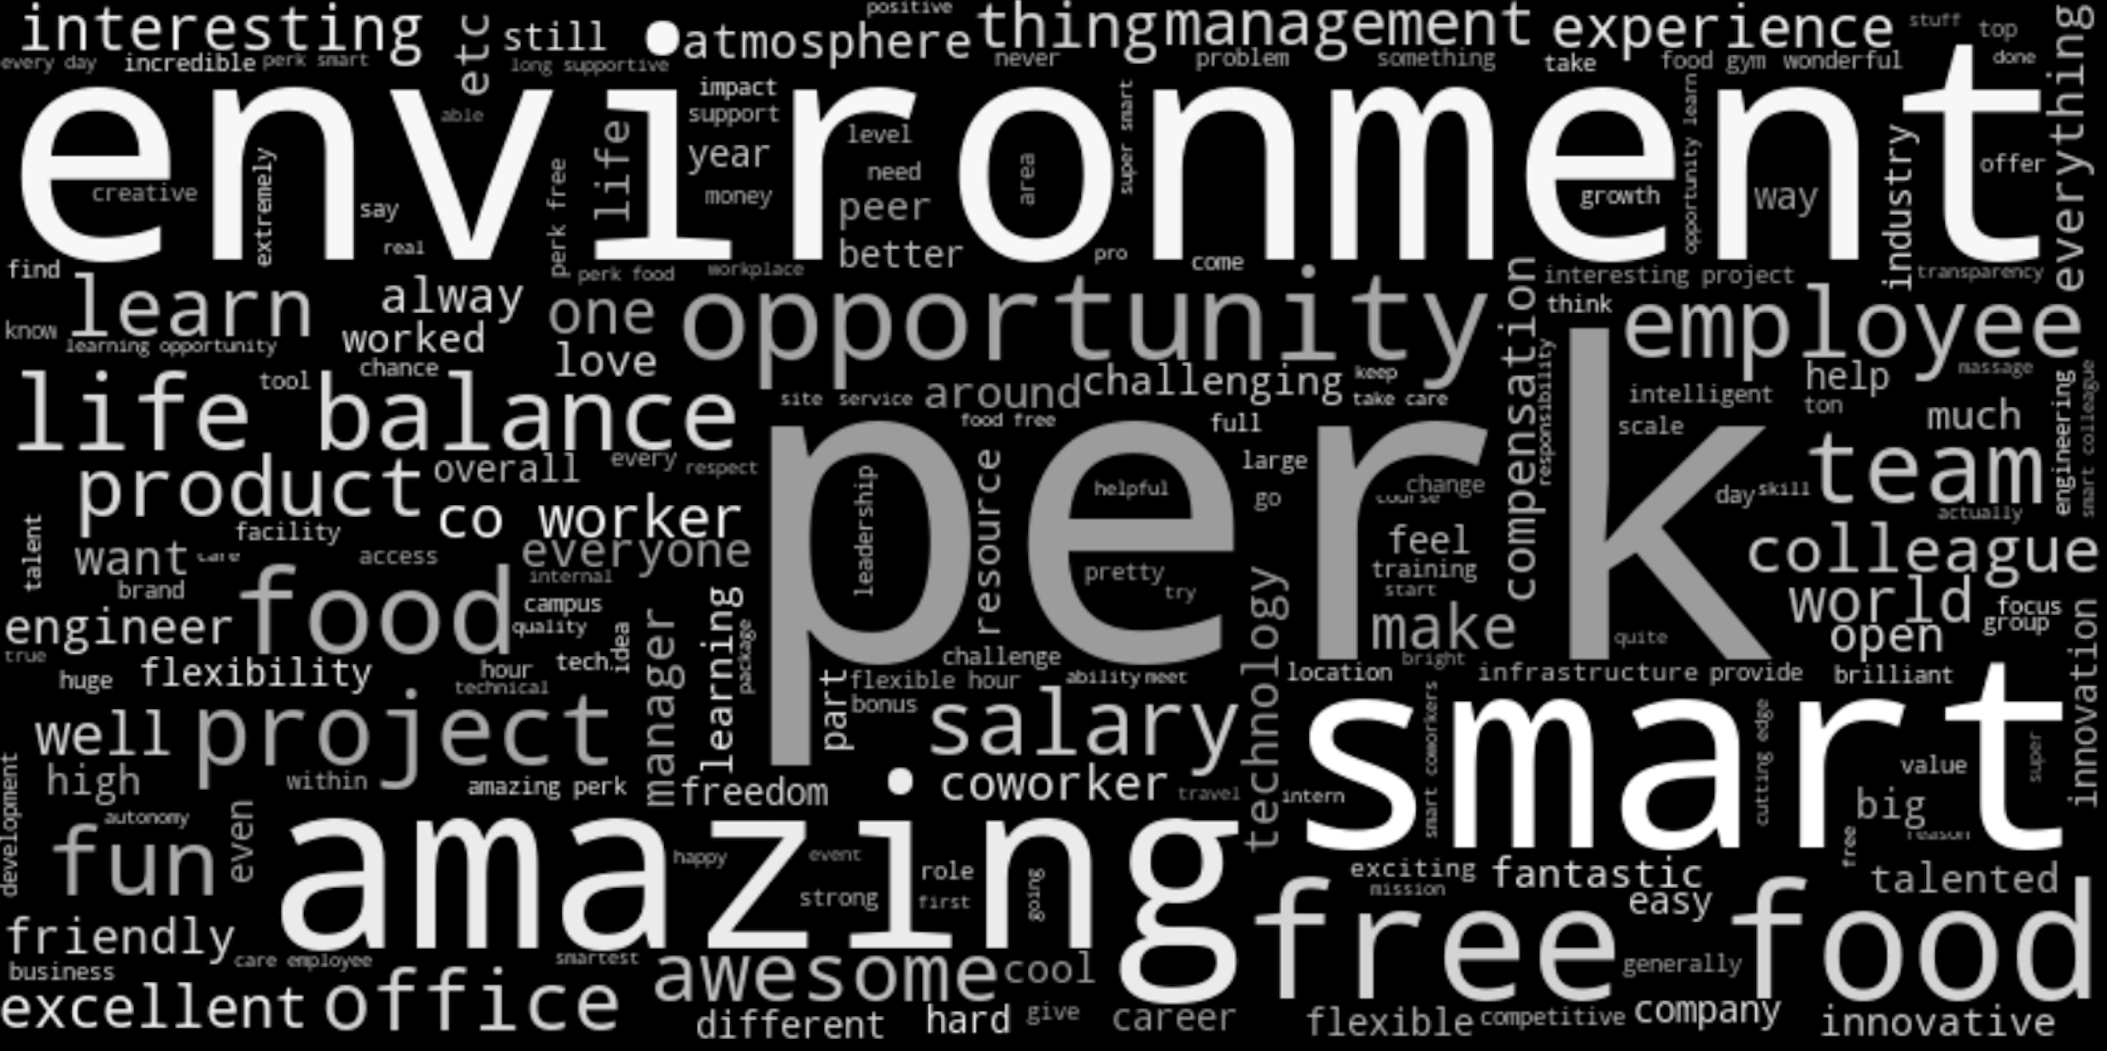
Word Cloud – Google Pros

Slide 18
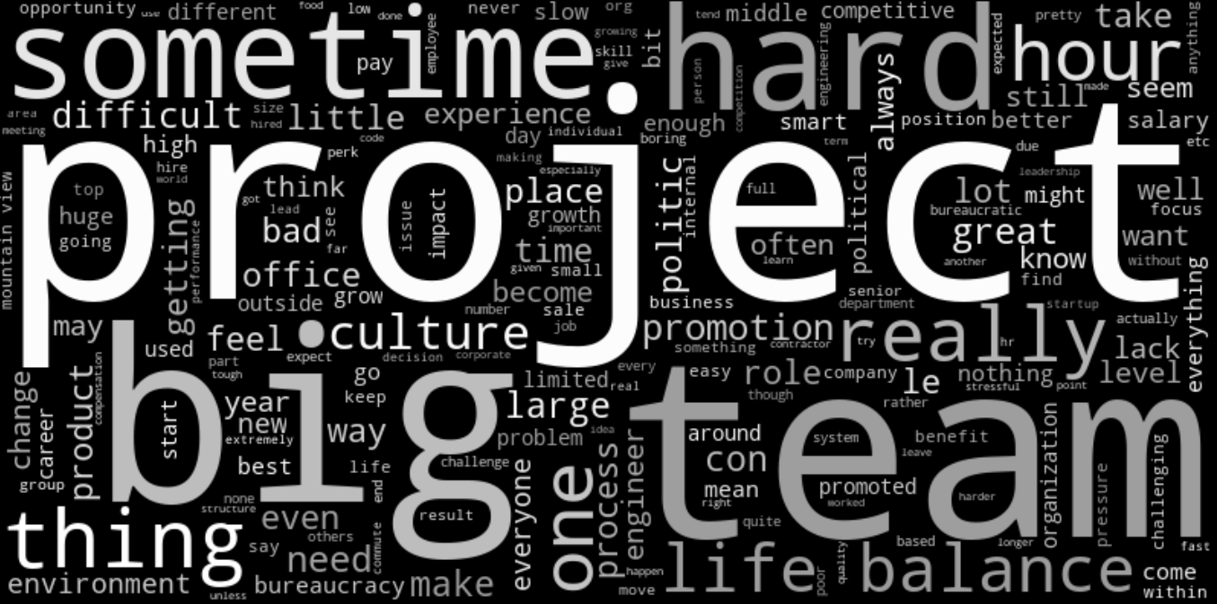
Word Cloud – Google Cons

Slide 19
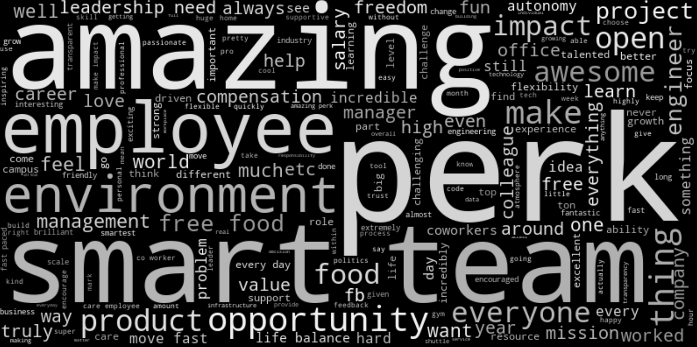
Word Cloud – Facebook Pros

Slide 20
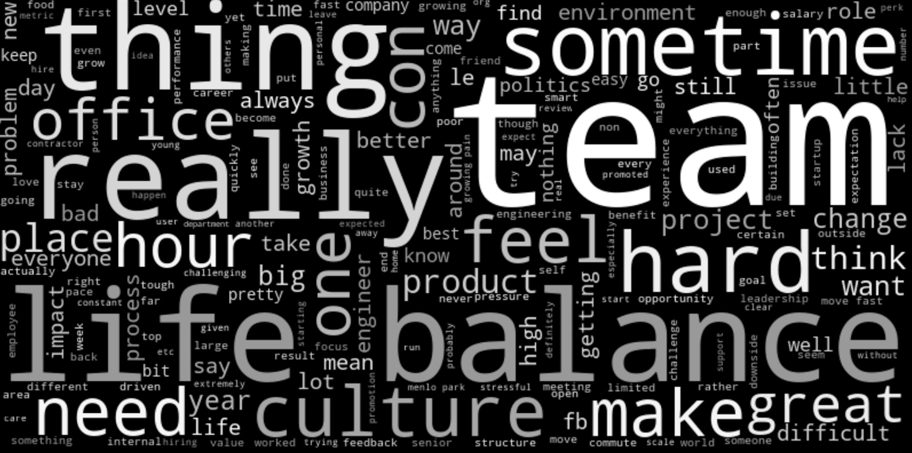
Word Cloud – Facebook Cons

Slide 21

Word Cloud – Microsoft Pros

Slide 22
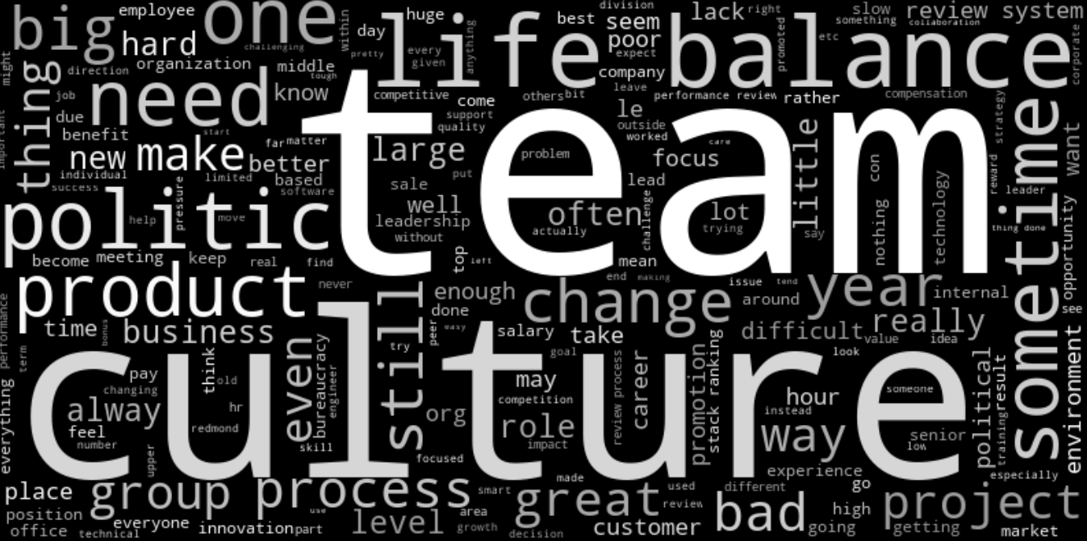
Word Cloud – Microsoft Cons

Slide 23
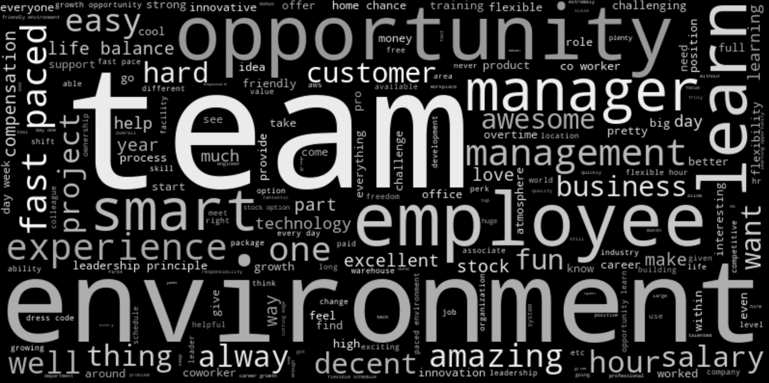
Word Cloud – Amazon Pros

Slide 24
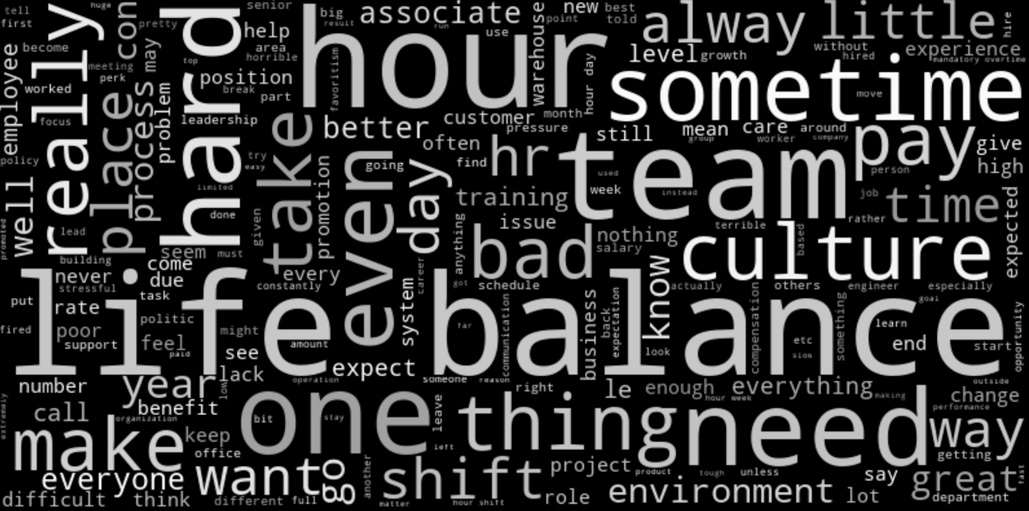
Word Cloud – Amazon Cons

Slide 25
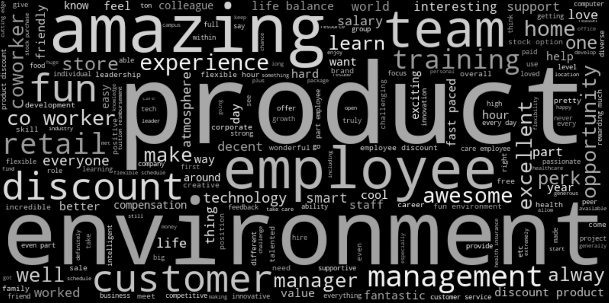
Word Cloud – Apple Pros

Slide 26
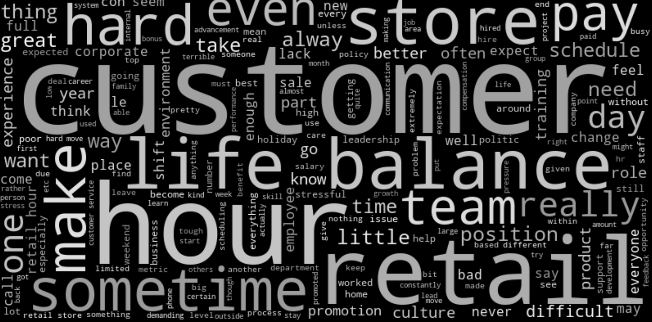
Word Cloud – Apple Cons

Slide 27

Word Cloud – Netflix Pros

Slide 28
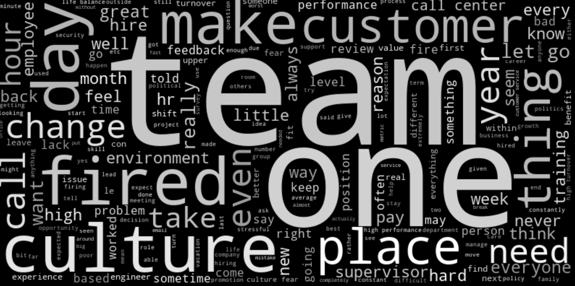
Word Cloud – Netflix Cons

Slide 29
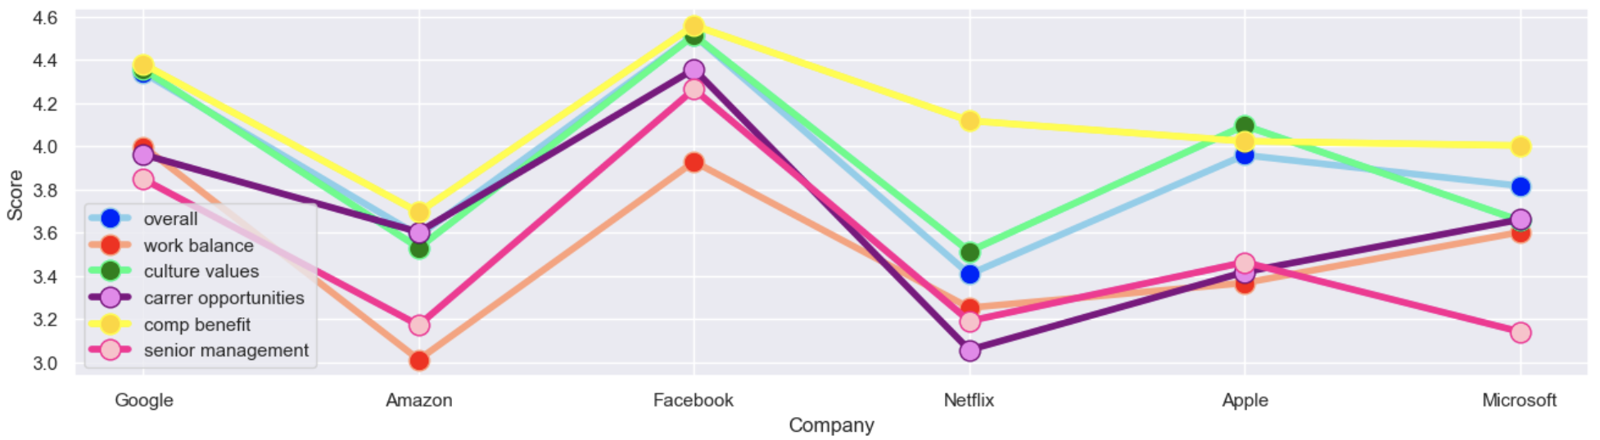
Score
Score
Overall
Work Balance
Culture Values
Overall
Work Balance
Culture Values
Career Opportunities
Company Benefit
Senior Management
Career Opportunities
Company Benefit
Senior Management

Slide 30




Method
Supervised Learning
Textual Classification
Sentiment Analysis
Sample
Label
Model
Test

Slide 31

Sample
Summary - “Best Company to work for”
Pros - “People are smart and friendly”
Cons - “Bureaucracy is slowing things down”
Convert to lower case
Remove punctuations
Remove stop words
Lemmatize Text
White space tokenization
Summary - [best, company, work]
Pros - [people, smart, friendly]
Cons - [bureaucracy, slowing, thing]
Sample - [best, company, work, people, smart, friendly, bureaucracy, slowing, thing]

Slide 32

Label
overall-ratings - 1.0, 2.0, 3.0, 4.0, 5.0
Binarization
3.0, 4.0, 5.0 = 1 (Positive)
1.0, 2.0 = 0 (Negative)
Binary Text Classification
Majority Vote - 0.8636810583713238
sample - [best, company, work, people, smart, friendly, bureaucracy, slowing, thing]
label - 1 (Positive)

Slide 33

Model
Tools
NLTK
Scikit-learn
Text Vectorization
Unigram Countvectorizer
Unigram & Bigram Countvectorizer
Unigram TFIDF Vectorizer
Algorithm
Multinomial Naive Bayes
Support Vector Machines
Evaluation
Accuracy
Average
Standard Deviation
10 Folds Cross-Validation
Base Line
Majority Vote

Slide 34
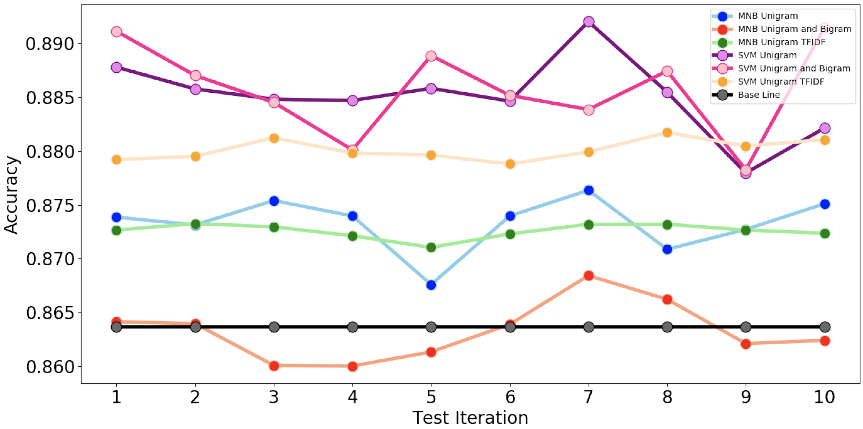
Test - Overall Evaluation Plot
MNB Unigram
MNB Unigram & Bigram
MNB Unigram TFIDF
Base Line
SVM Unigram
SVM Unigram & Bigram
SVM Unigram TFIDF

Slide 35

Test - Overall Evaluation Table
Model\Vectorizer | Uni Count |  | Uni & Bi Count |  | Uni & Bi TFIDF
MNB | 0.873 | +/- 0.002 | 0.863 | +/- 0.003 | 0.873 | +/- 0.001
SVM | 0.885 | +/- 0.003 | 0.886 | +/- 0.004 | 0.880 | +/- 0.001
Best - SVM with Uni & Bi Countvectorizer achieved 0.886 average accuracy over 10 folds cross-validation
SVM basically is better than MNB
Tricks are problem specific such as stemming, n-gram, feature representation, etc.

Slide 36






Conclusion
Both Facebook and Google are good work places
Employees now are more active to express themselves
Former employees are happier
The balance between work and life is a big problem
Most companies are trying to be better than yesterday
Yet, companies did not pay much attention on work balance
Companies care more about culture values and benefits

Slide 37


Thank you for your attention
Q&A

